Slide 1
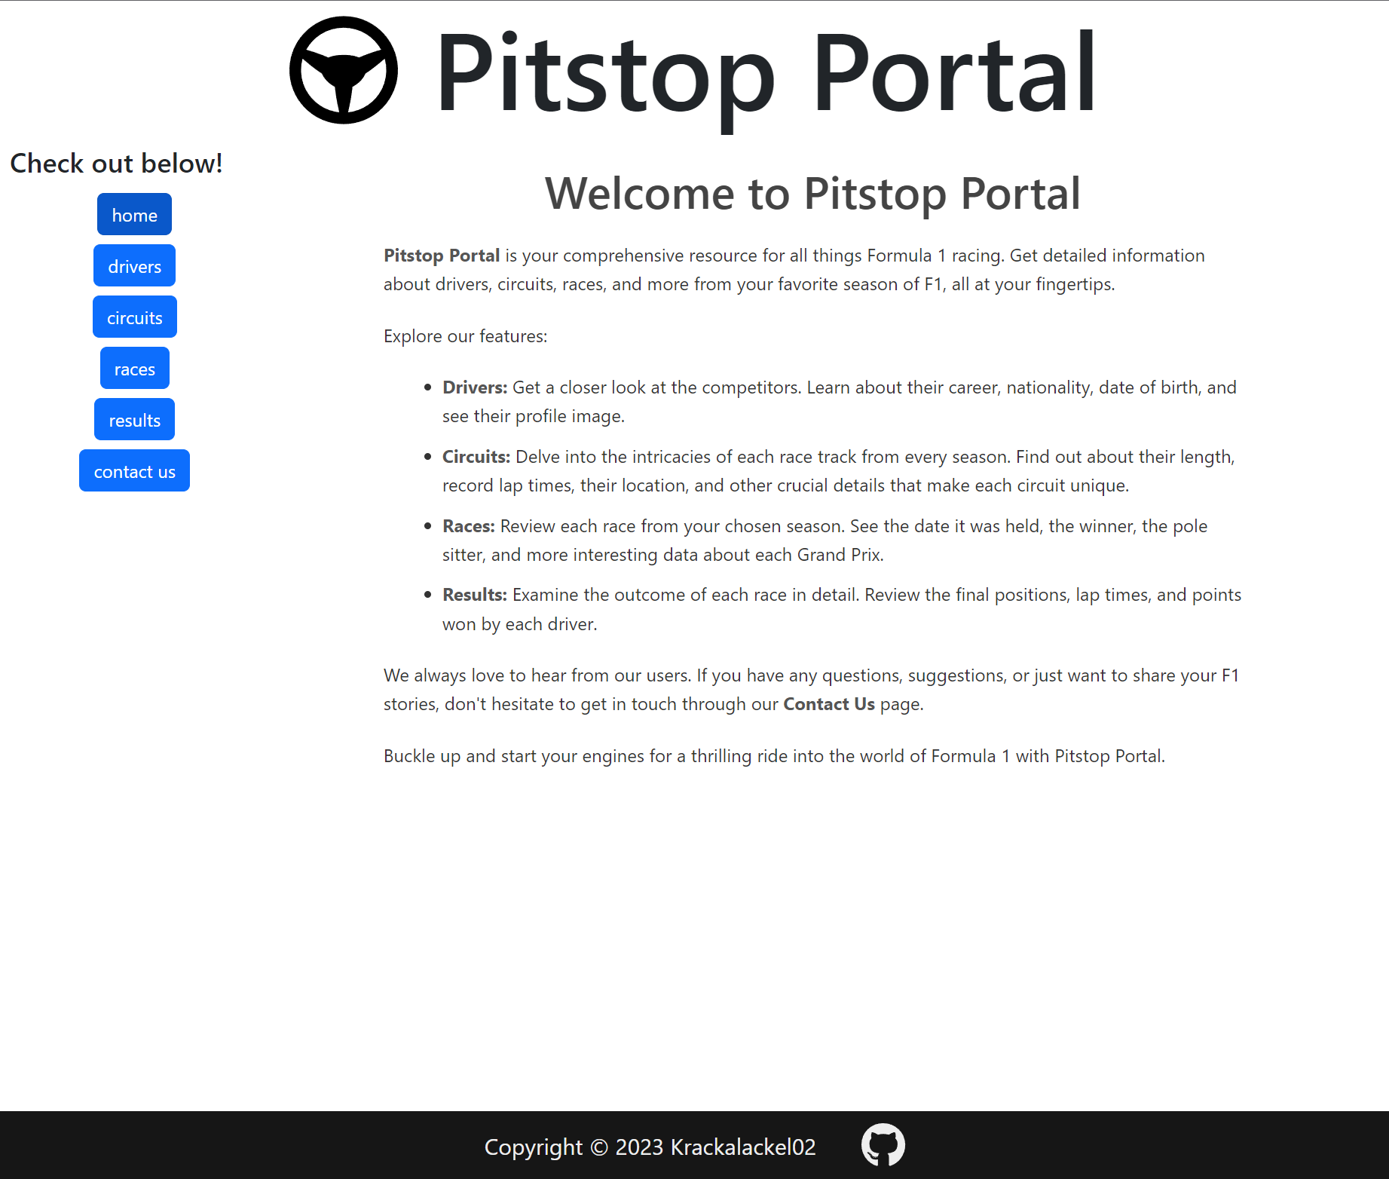

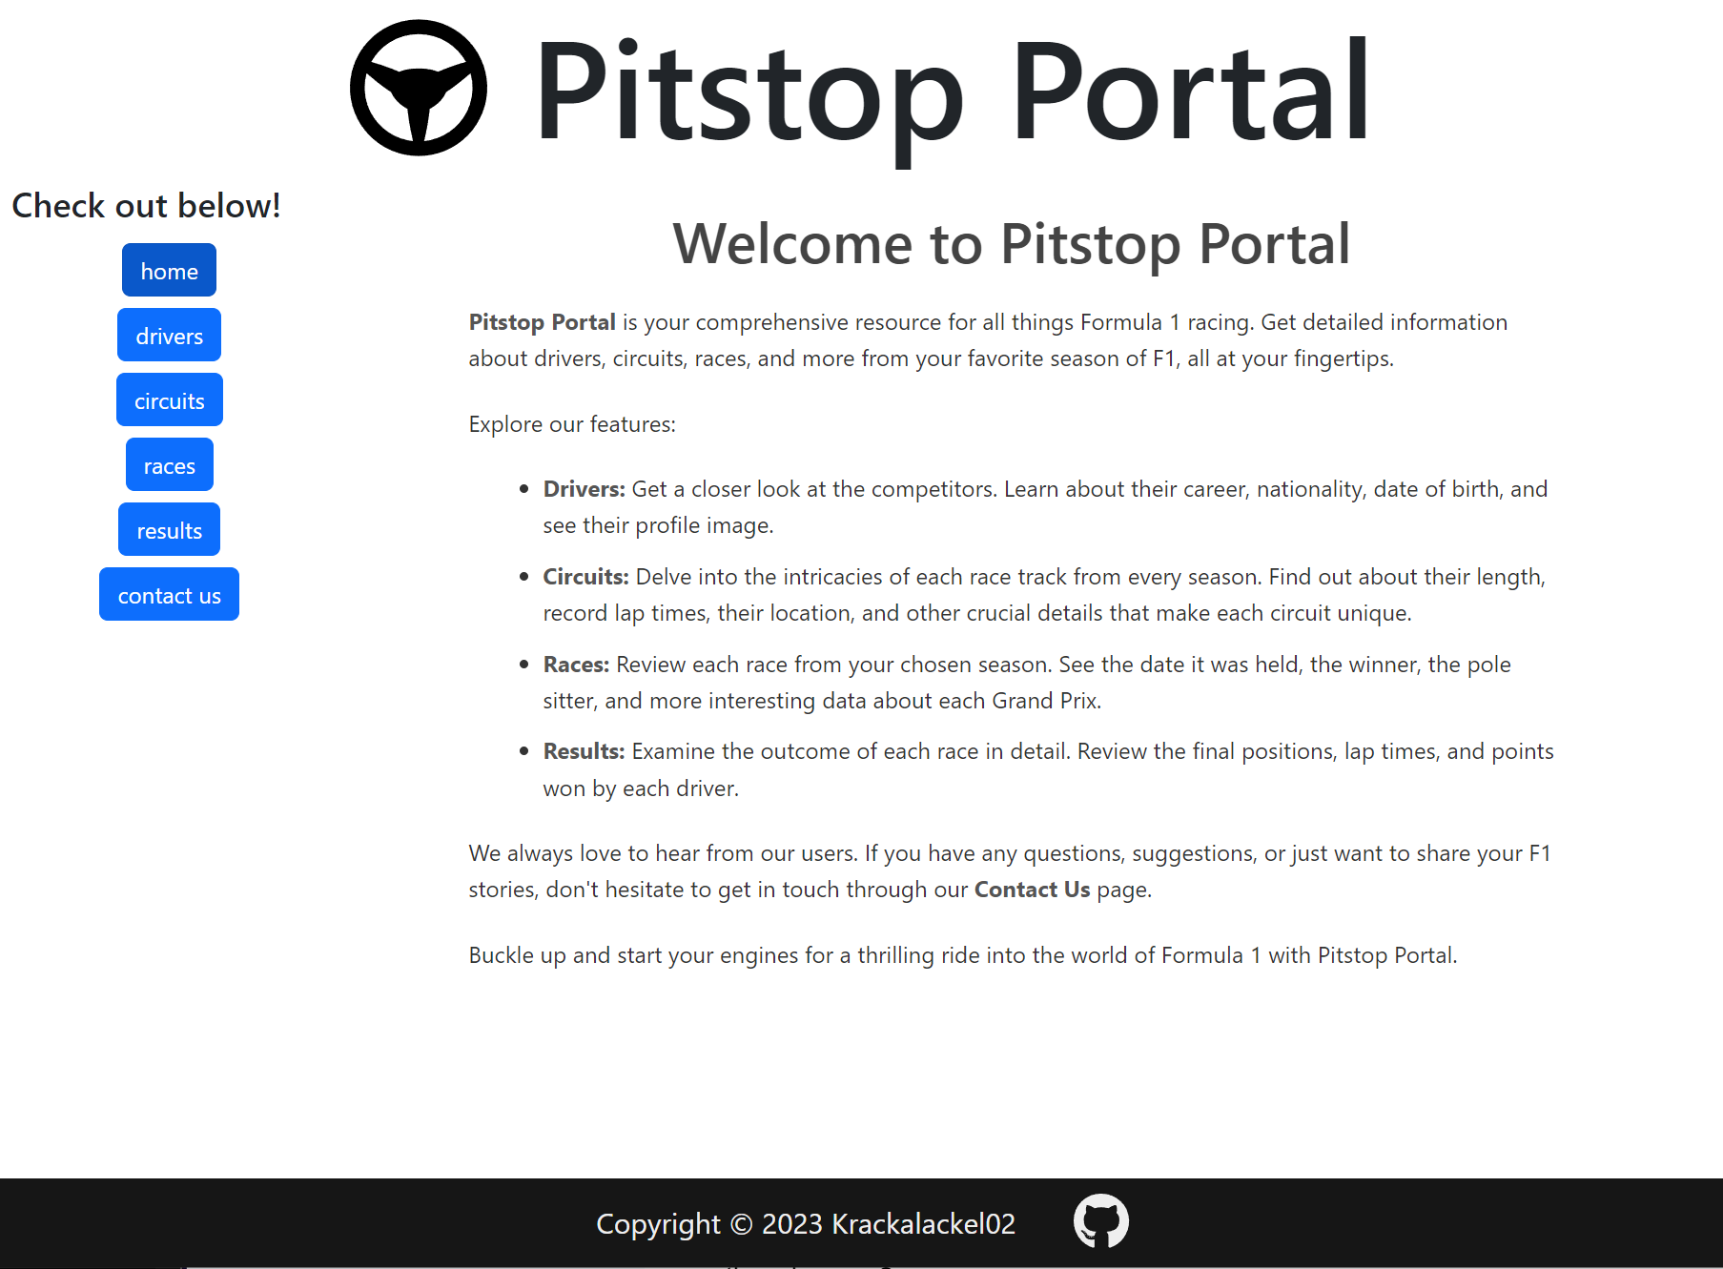

Contents
Core Functionality
Project Management
Code
Problems
Improvements
Web app to produce up-to-date F1 statistics from as early as 1970 up to the current season.

Slide 2
Drivers
Contents
When viewing a given season’s list of drivers the user can learn more about them via their birthday, nationality and driver number; along with a link to their respective Wikipedia entry
Core Functionality
Project Management
Code
Problems
Improvements

Slide 3
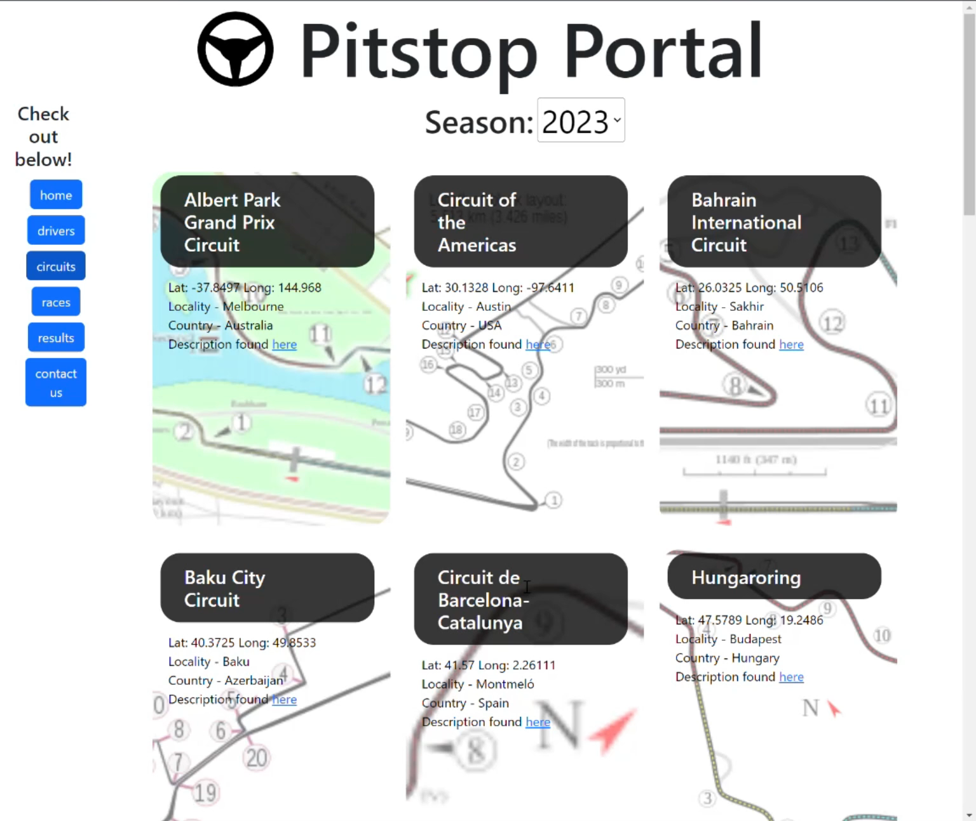
Circuits
Drivers
When viewing a given season’s list of drivers the user can learn more about them e.g. their birthday, nationality and driver number; along with a link to their respective Wikipedia entry
Each circuit has its map available and location data shown, along with a link to its Wikipedia for more info

Slide 4
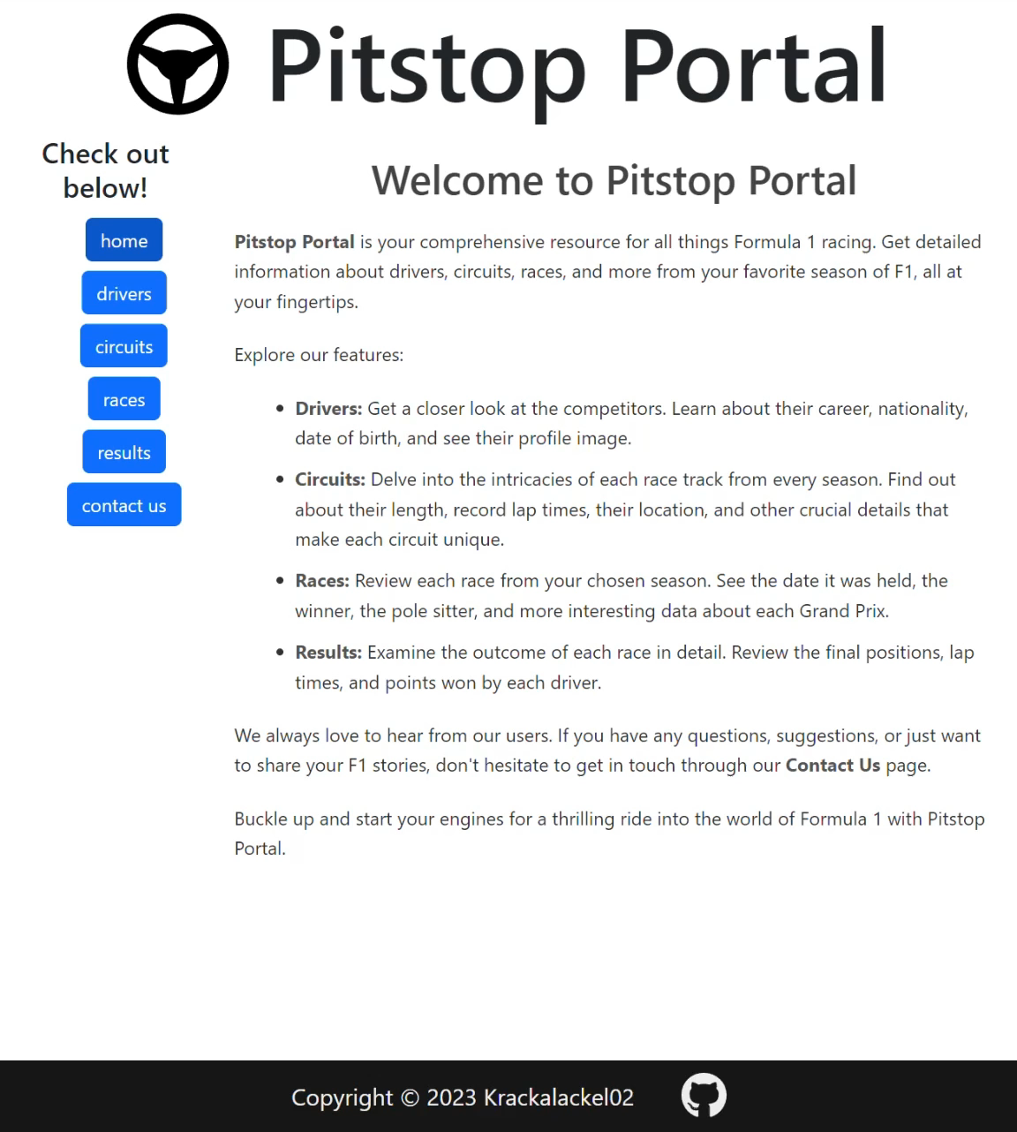
Races
Circuits
The race schedule is also available for each season, with more recent years showing the local times for each days events like Practice, Qualifying and Race Day.
Each circuit has its map available and location data shown, along with a link to its Wikipedia for more info

Slide 5
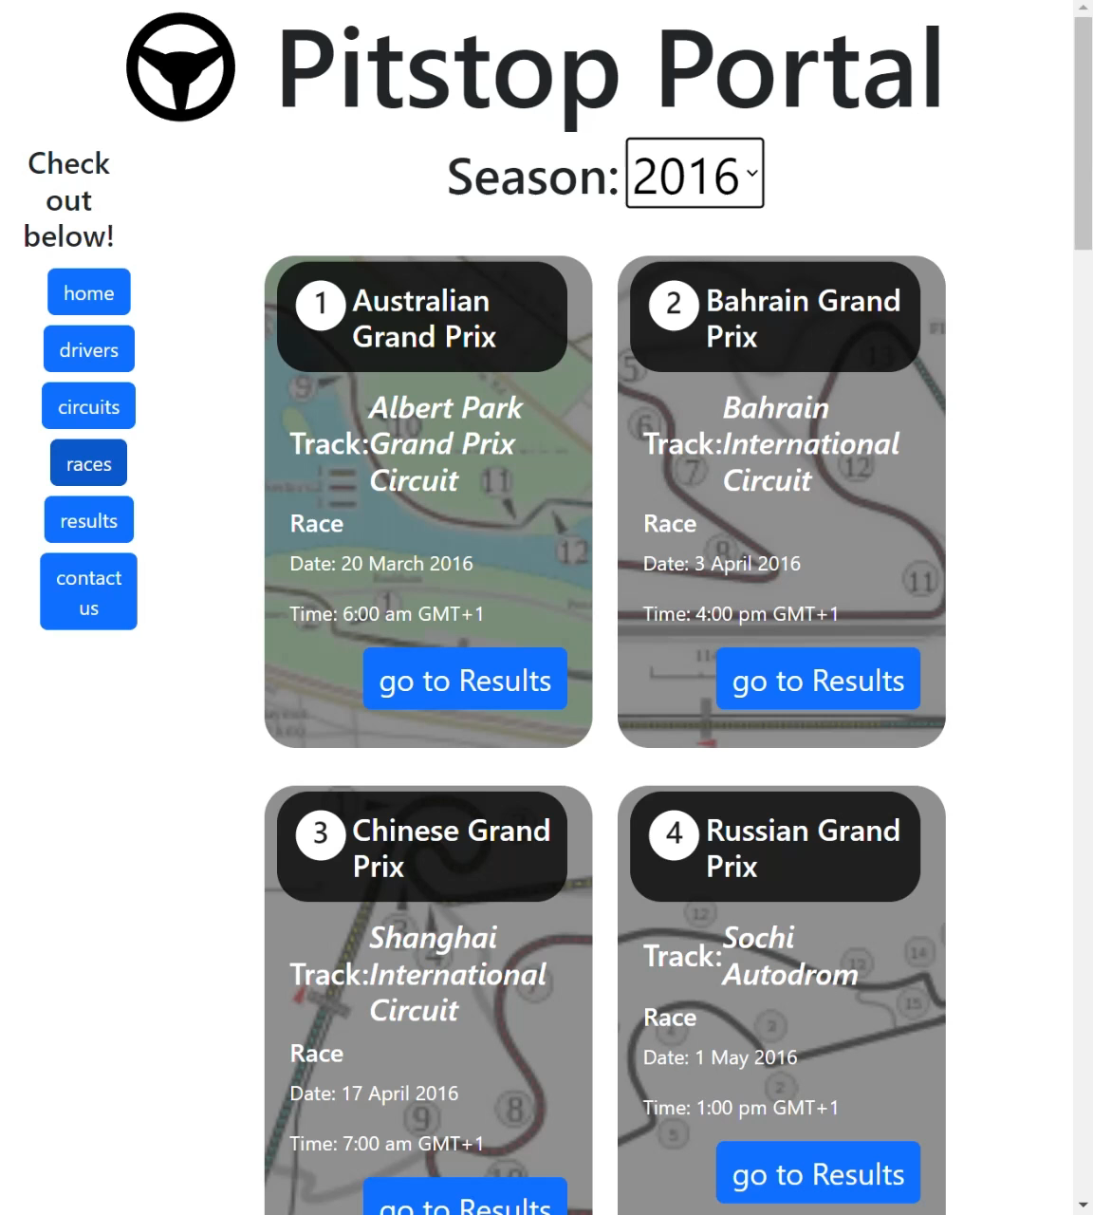
Results
Races
The race schedule is also available for each season, with more recent years showing the local times for each days events like Practice, Qualifying and Race Day.
When clicking “Go to Results”, the user can view the three podium winners for any race and see each drivers fastest lap times.

Slide 6
Project Management
Results
API Fetch
React UI
Testing
Bootstrap
When clicking “Go to Results”, the user can view the three podium winners for any race and see each drivers fastest lap times.

Slide 7
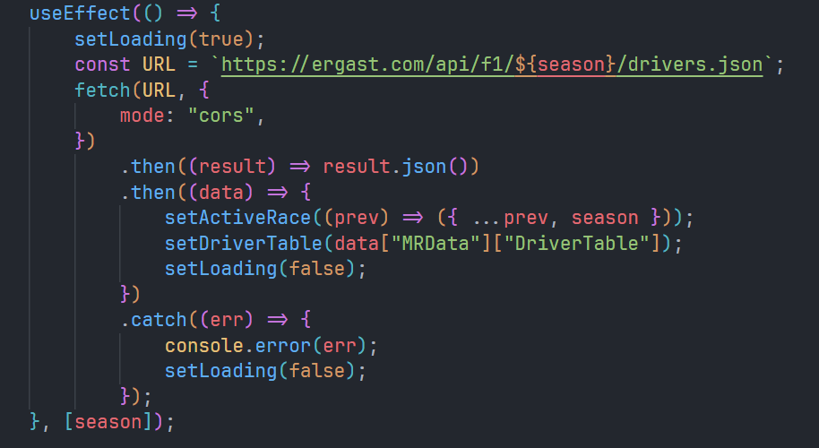
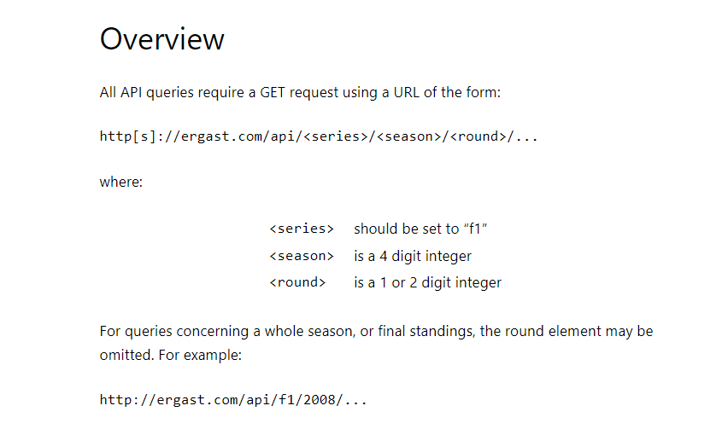
Fetching from Race API
Project Management
Ergast
Fetch Resources
React UI
Testing
Bootstrap

Slide 8
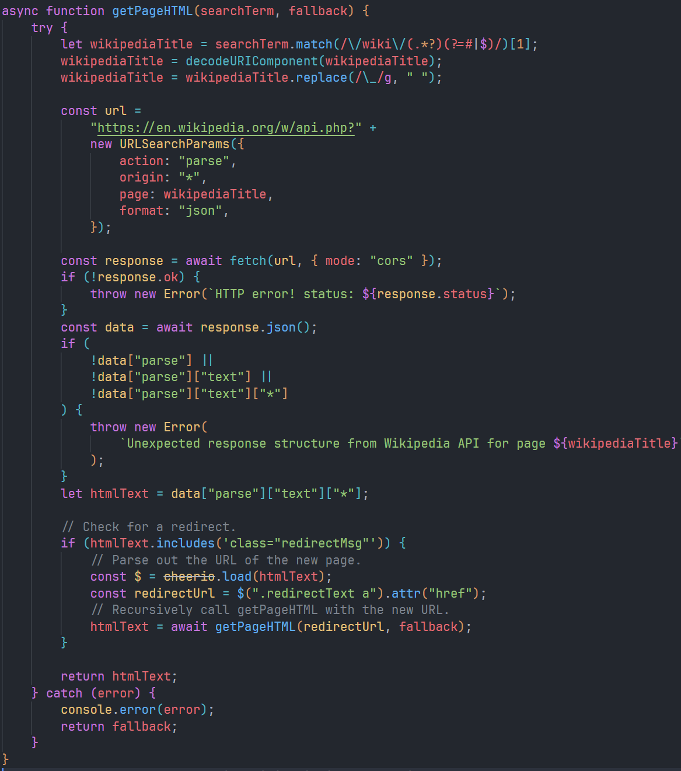
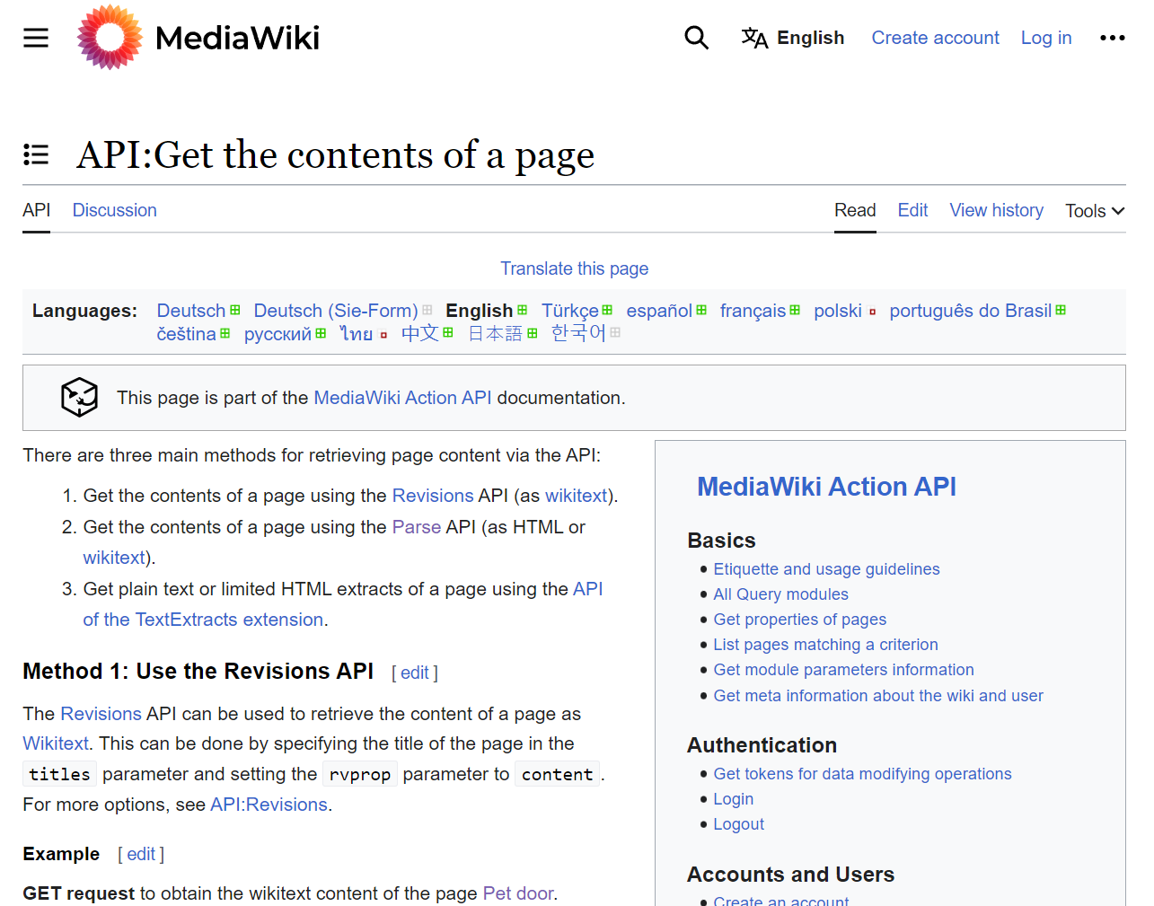
Web Scraping with Library
Fetching from Race API
Wiki
Ergast

Slide 9
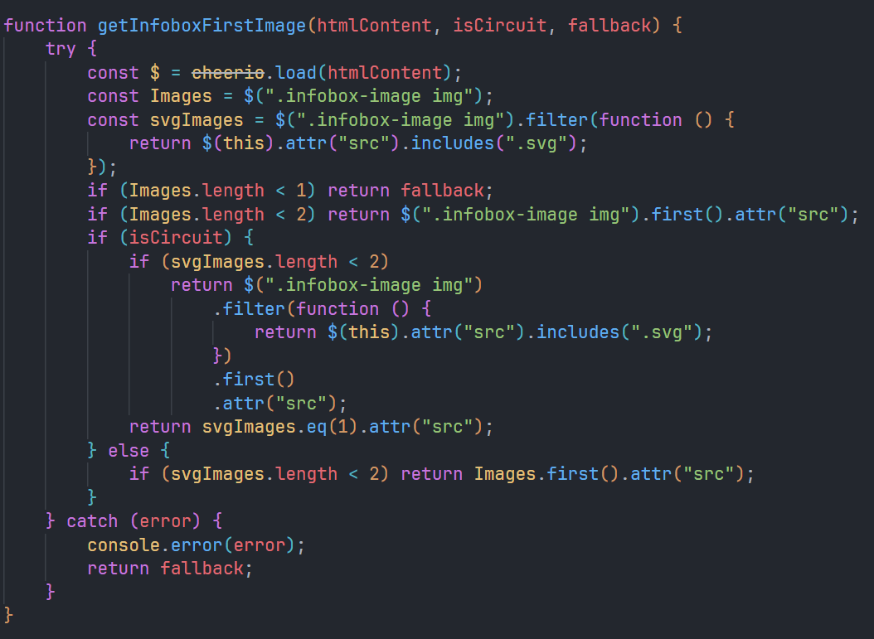
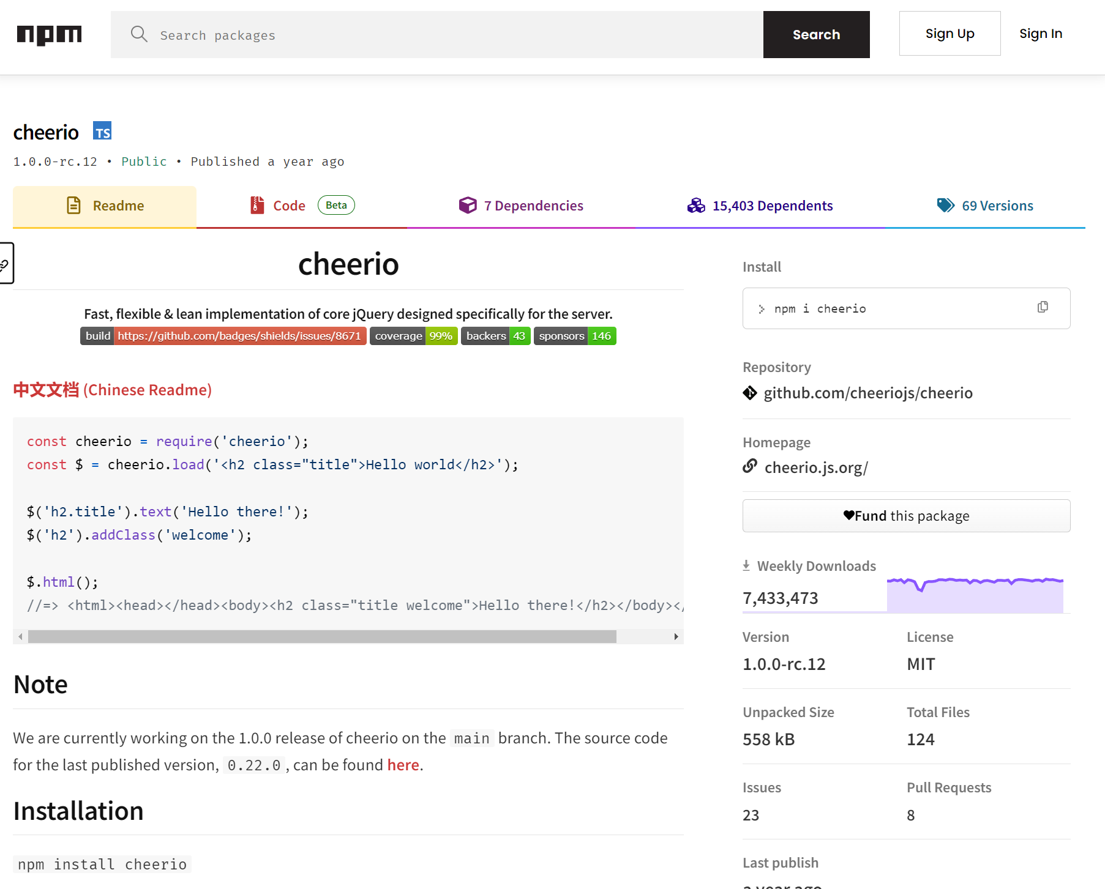
Web Scraping with Library
Fetching from Wiki API
Cheerio
Wiki

Slide 10
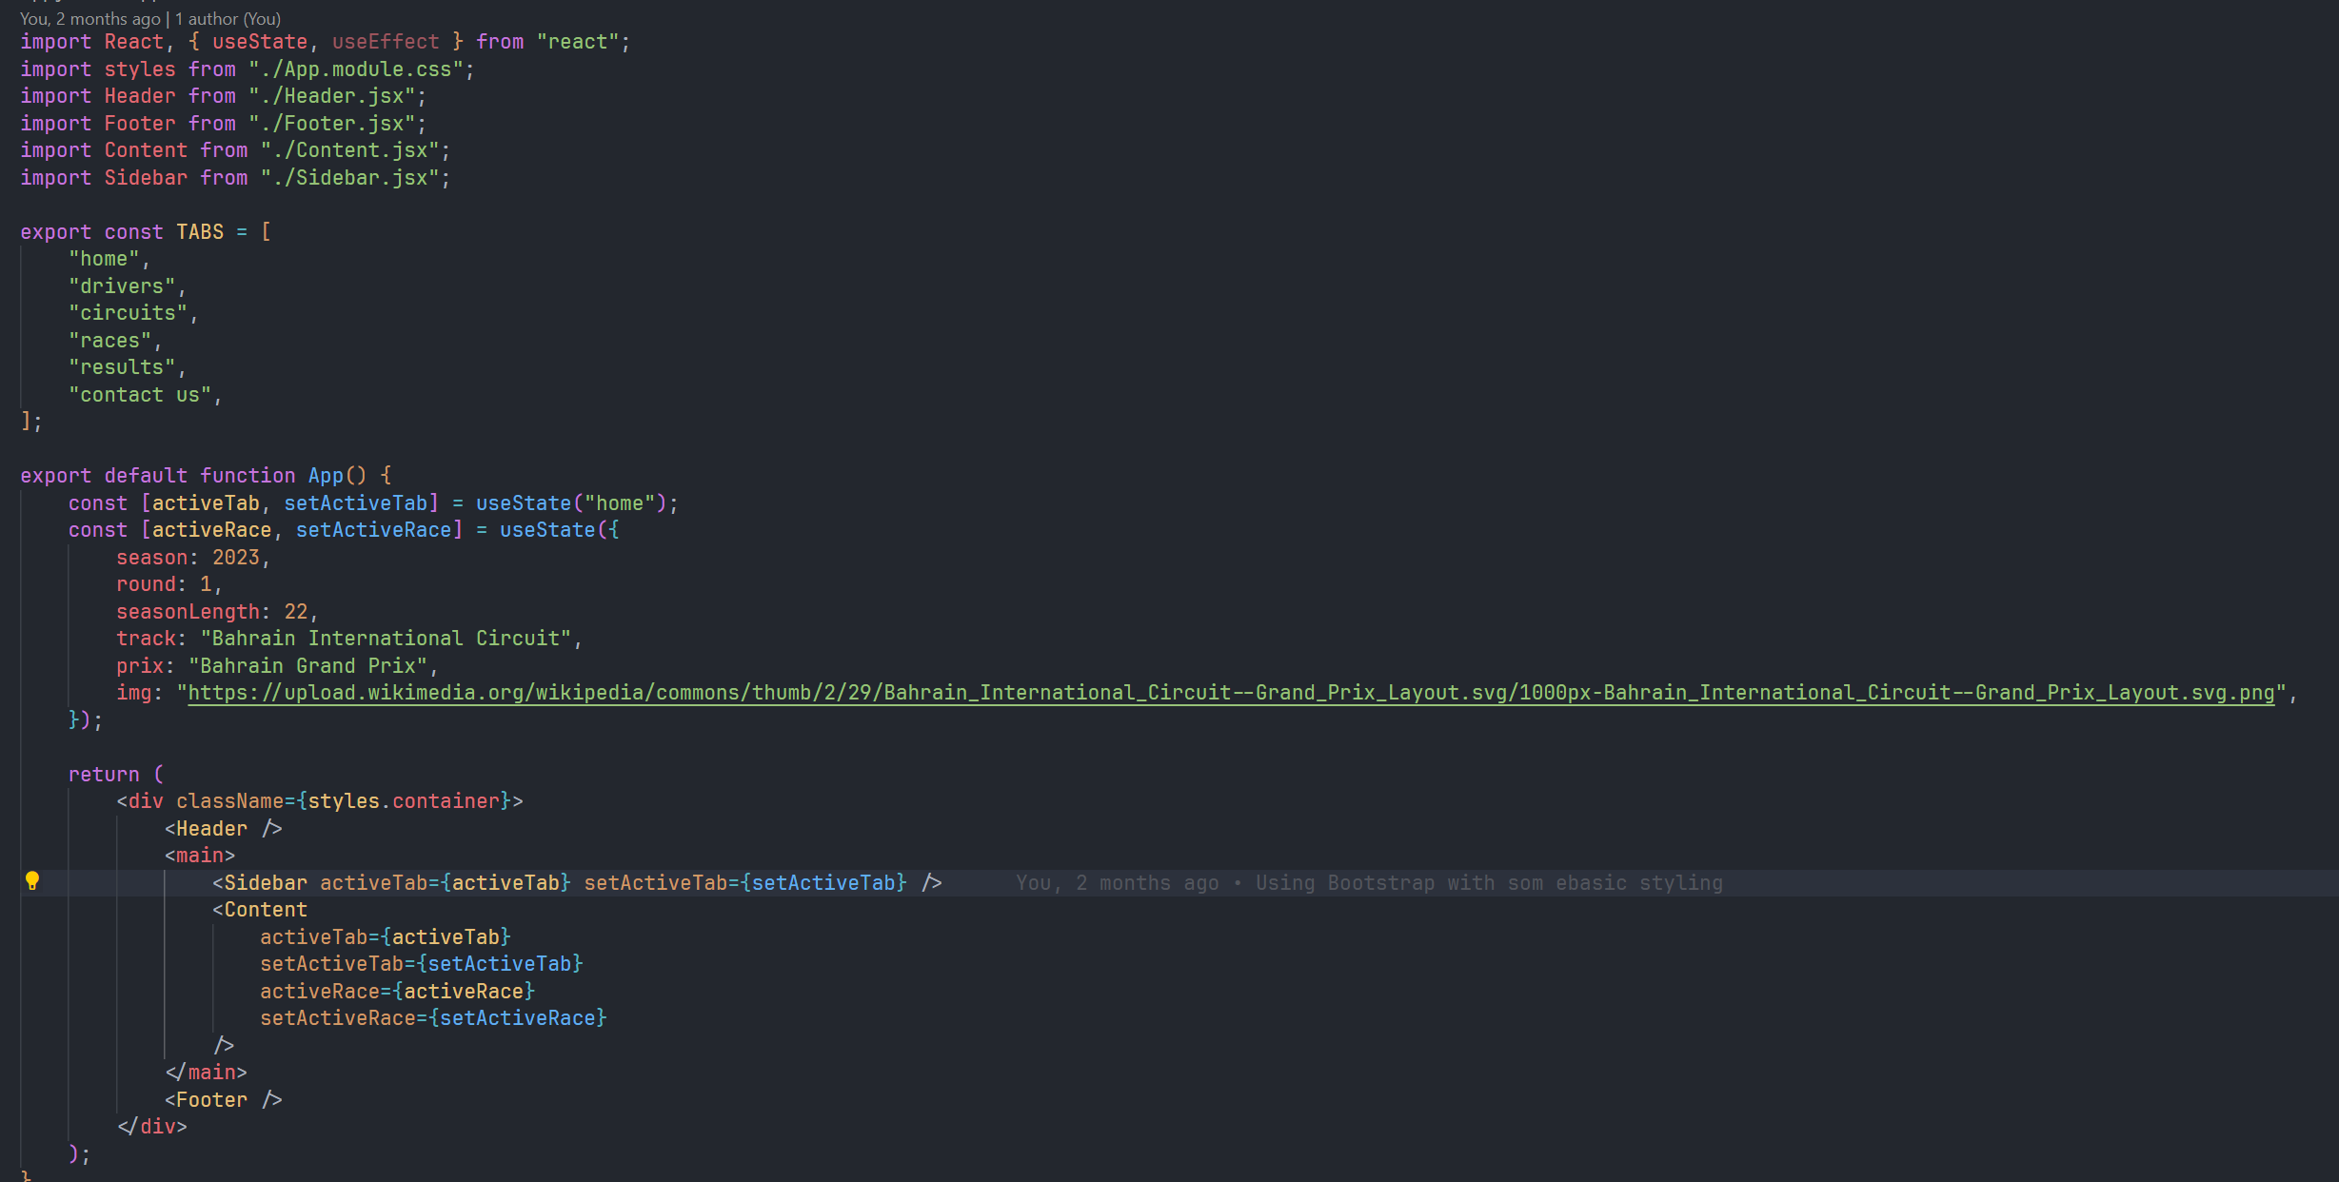
Implementing React UI
Web Scraping with Library
Cheerio

Slide 11
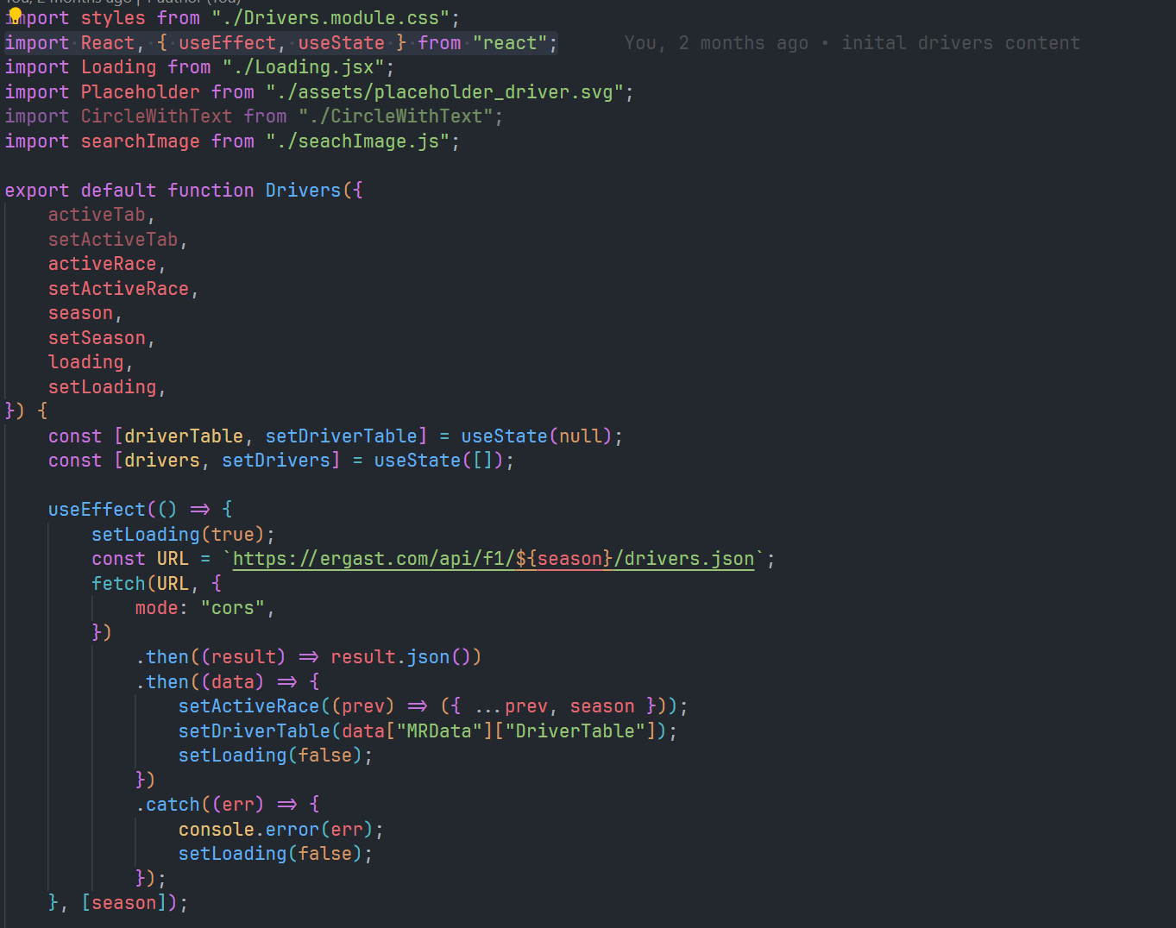
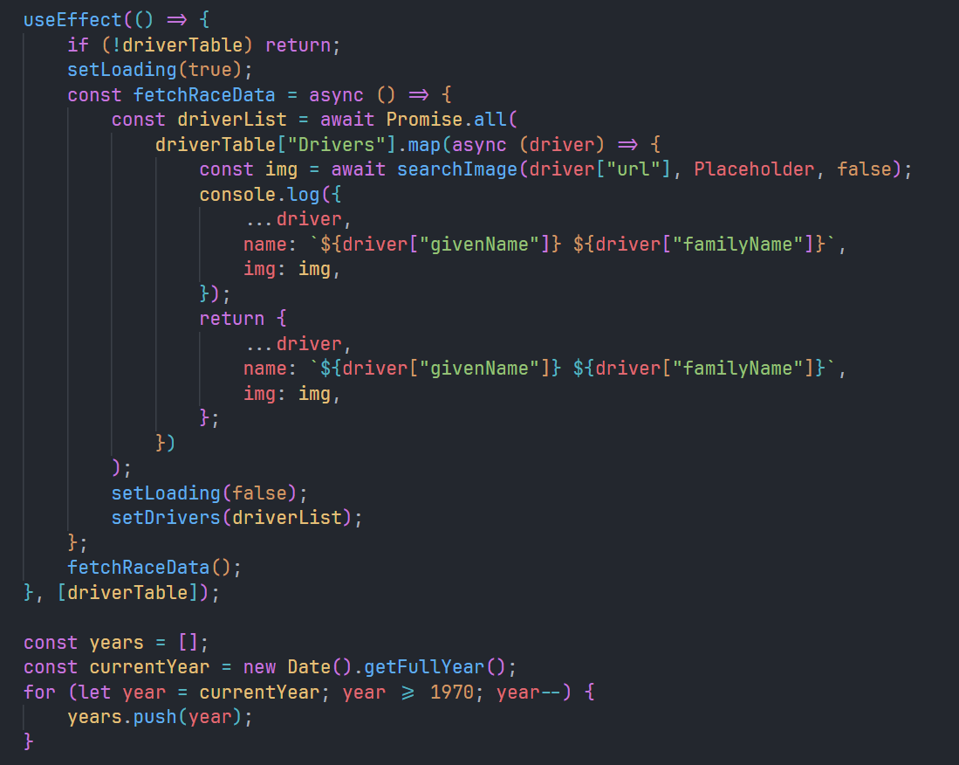
Driver Component:
useEffect()
Implementing React UI

Slide 12
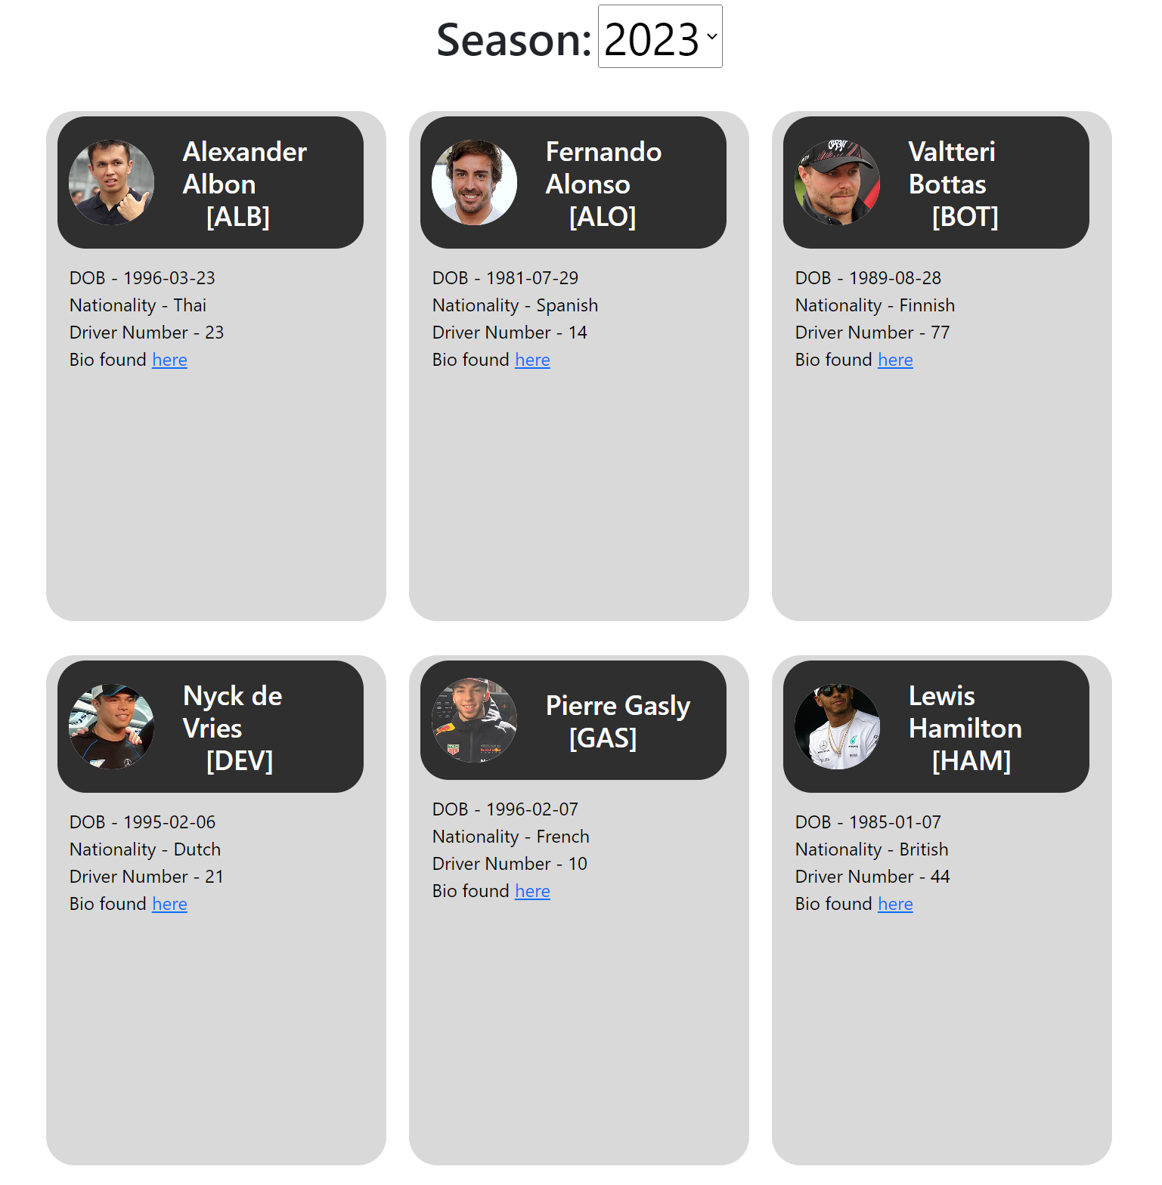
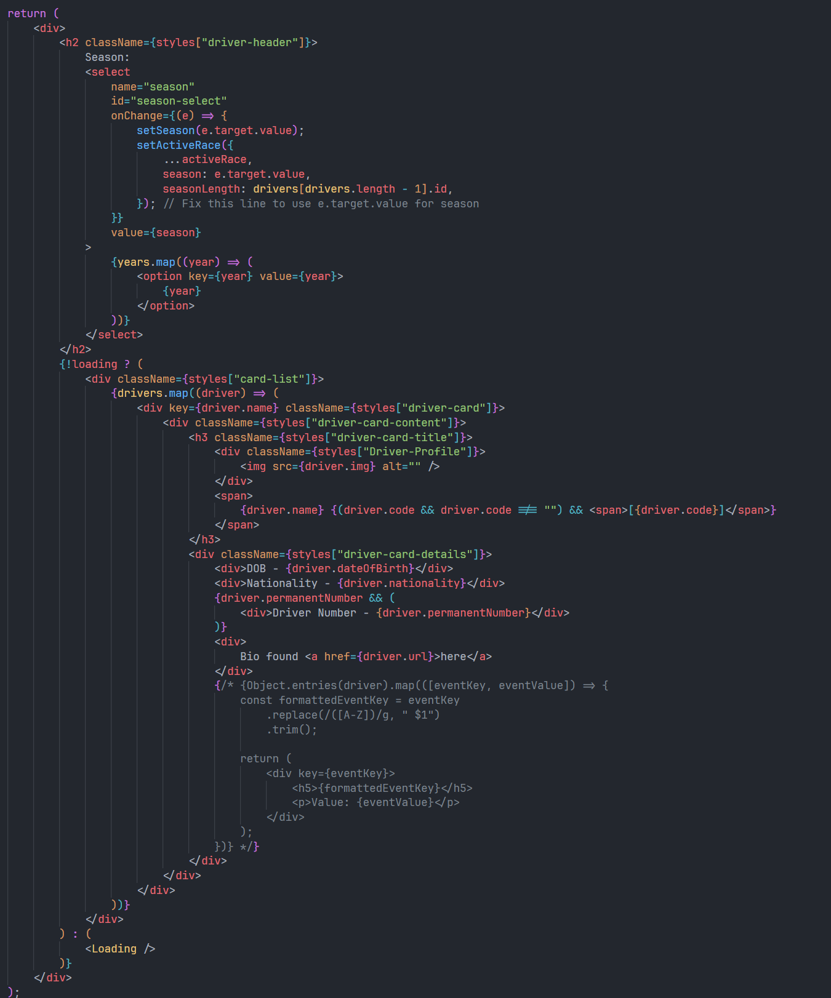
HTMX
Driver Component:
useEffect()

Slide 13


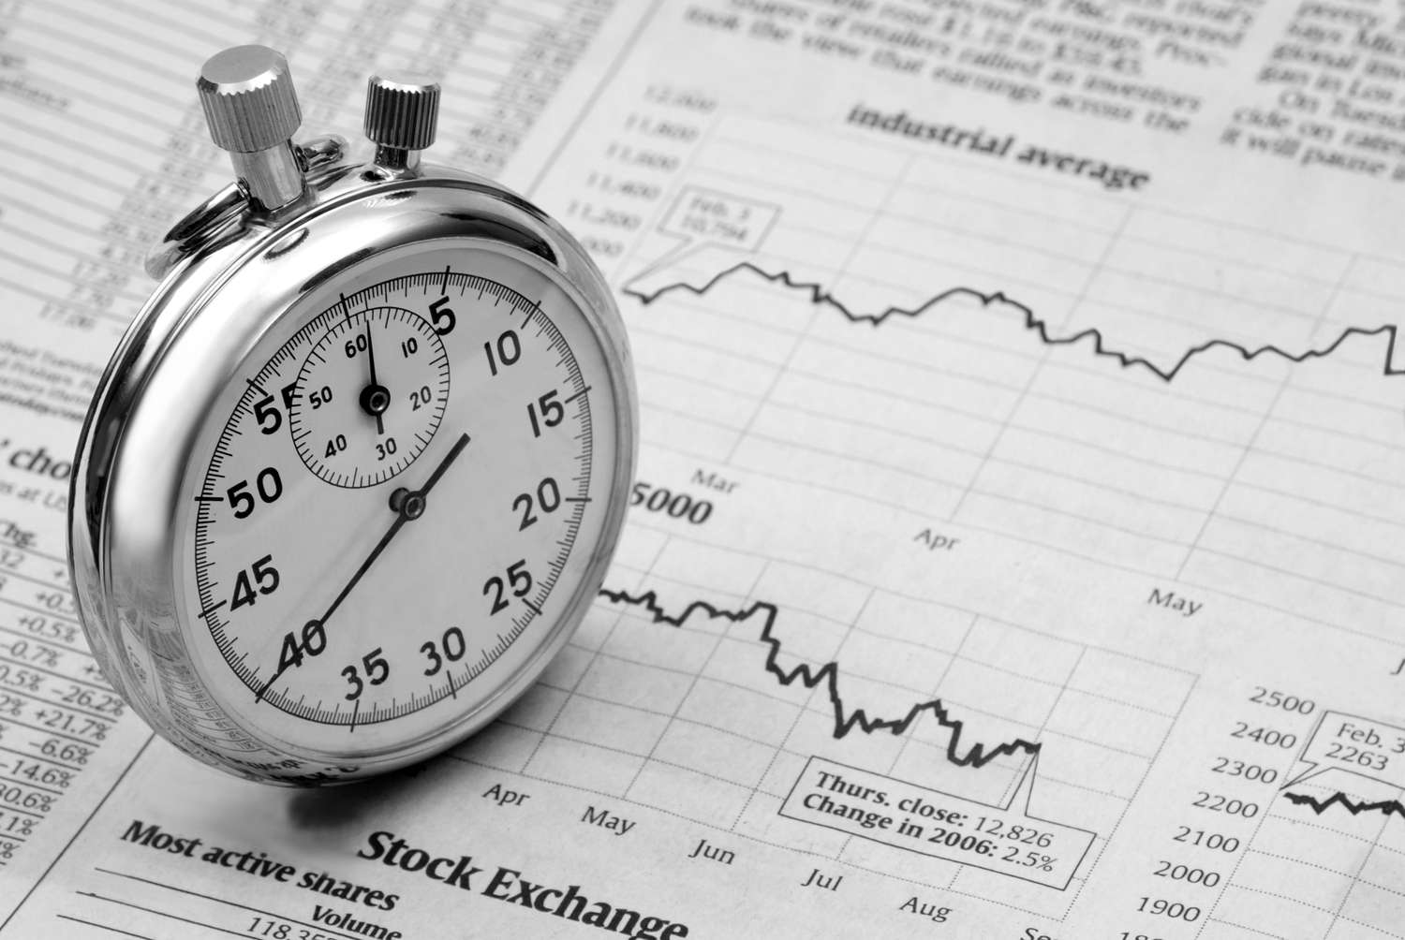
Problems:
Driver Component:
HTMX
Loading
Times
Lack of other features
Prop Drilling & Separation of Concerns

Slide 14



Improvements & Solutions:
Problems:
Loading
Times
Lack of other features
Used to store both fetched race data and requested Wikipedia image URLs to improve load time of given content
User Interaction & Feedback
Prop Drilling & Separation of Concerns
State Management
Database
Graphing

Slide 15

Improvements & Solutions:
Used to store both fetched race data and requested Wikipedia image URLs to improve load time of given content
User Interaction & Feedback
State Management
Database
Graphing

Slide 16
Improvements & Solutions:
Used to store both fetched race data and requested Wikipedia image URLs to improve load time of given content
Used to reduce amount of prop drilling, clean up code and offer better global state management
User Interaction & Feedback
State Management
Database
Graphing

Slide 17
Improvements & Solutions:
Used to reduce amount of prop drilling, clean up code and offer better global state management
If other race data like each lap time per driver found from other API then using D3 to plot and show more statistics
Used to store both fetched race data and requested Wikipedia image URLs to improve load time of given content
User Interaction & Feedback
State Management
Graphing
Database

Slide 18
Improvements & Solutions:
If other race data like each lap time per driver found from other API then using D3 to plot and show more statistics
Adding more user interaction like feedback for site via HTTP form to Google Sheet and more filters for data e.g. “Spanish drivers this season”
Used to store both fetched race data and requested Wikipedia image URLs to improve load time of given content
Used to reduce amount of prop drilling, clean up code and offer better global state management
User Interaction & Feedback
State Management
Database
Graphing

Slide 19
Improvements & Solutions:
Adding more user interaction like feedback for site via HTTP form to Google Sheet and more filters for data e.g. “Spanish drivers this season”
If other race data like each lap time per driver found from other API then using D3 to plot and show more statistics
Used to store both fetched race data and requested Wikipedia image URLs to improve load time of given content
User Interaction & Feedback
State Management
Database
Graphing

Slide 20
Thank You
Adding more user interaction like feedback for site via HTTP form to Google Sheet and more filters for data e.g. “Spanish drivers this season”
If other race data like each lap time per driver found from other API then using D3 to plot and show more statistics
Used to store both fetched race data and requested Wikipedia image URLs to improve load time of given content
Used to reduce amount of prop drilling, clean up code and offer better global state management
State Management
User Interaction & Feedback
Database
Graphing

